Slide 1
Quality function deployment (qfd)
Project Management

Slide 2
Definition
Quality Function Deployment (QFD) is a process developed in Japan by Yoji Akao in 1966.
These process and set of tools used to effectively define customer requirements and convert them into detailed engineering specifications and plans to produce the products that fulfill those requirements.

Slide 3
The Purpose of QFD
Effective communication is one of the most important and impactful aspects of any organization’s success. QFD methodology effectively communicates customer needs to multiple business operations through the forward steps:
focus on customers wants, not what the company thinks the customer wants.(The Voice of the Customer VOC)
Reduce development time.
Reduce development cost.

Slide 4
The Purpose of QFD (cont’d)
Structure and Documentation: QFD provides a structured method and tools for recording decisions made during the process.
That helps engineer to use the data to focus on product design feature.
Marketing uses this input for identifying marketing strategies.

Slide 5
How to Implement QFD
The core of this process is a chart called House of Quality, it’s constructed by answering the following five questions:
What do our customer need and want (Product Definition) ..? Begins with collection of VOC and translating the customer wants and needs into product specifications.
In terms of our customer, who well we doing relative to our possibilities (Voice of the Engineer) ..? Define the critical points due to the organization’s possibilities. الاحتمالات

Slide 6
How to Implement QFD (cont’d)
What are the relationships between the voice of the customer and the voice of the engineer ..? A comparison between requirements of the customer and the organization possibilities to define technical rules.
How does our product or service performance ..? Define how the product will achieve the customers’ requirements.
What are the potential technical trade offs ..? Determine how to achieve the highest profit with the least cost.
الموازنة

Slide 7
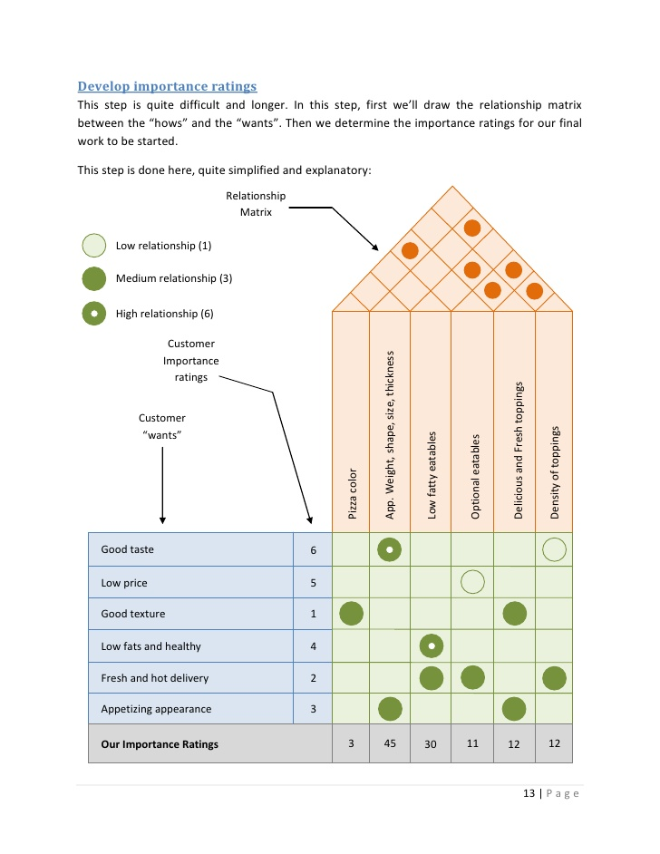

Slide 8
Resources
https://quality-one.com/qfd/
http://asq.org/learn-about-quality/qfd-quality-function-deployment/overview/overview.html
https://en.wikipedia.org/wiki/Quality_function_deployment
https://it.toolbox.com/blogs/craigborysowich/benefits-of-using-qfd-120406
https://www.isixsigma.com/dictionary/voice-of-the-customer-voc/
https://www.youtube.com/watch?v=kW79CcSkoeo
https://www.slideshare.net/MuhammadHaris/qrd-for-pizza

Slide 9

Thank you
Mohamed EL-Saied

